Slide 1
Structured Query Language
SQL stands for Structured Query Language
SQL is a standard language for accessing and manipulating databases.
SQL is an ANSI (American National Standards Institute) standard
SQL is a Database Independent i.e. all the major Databases supports SQL quires like[ SQLSERVER, MySql,Oracle,Msaccess,Sybase etc]
SQL is not case sensitive

Slide 2
Structured Query Language
What Can SQL do?
SQL can execute queries against a database
SQL can retrieve data from a database
SQL can insert records in a database
SQL can update records in a database
SQL can delete records from a database
SQL can create new databases
SQL can create new tables in a database
SQL can create stored procedures in a database
SQL can create views in a database
SQL can set permissions on tables, procedures, and views

Slide 3
SQL DML and DDL
SQL can be divided into two parts:
Data Definition Language (DDL)
The Data Manipulation Language (DML)
Data Definition Language (DDL):
Creates a new database
Creates a new table
Modifies a database
Modifies a table
Deletes a table
Imposes constraints between tables
Creates an index (search key)
Deletes an index
Keywords Supported In DDL:
Create ,Alter ,Drop

Slide 4
SQL DML and DDL
The Data Manipulation Language (DML): DML queries allows following things.
Inserts new data into a database Table
Extracts data from a database Table
Updates data in a database Table
Deletes data from a database Table

Slide 5
DDL(Data Definition Language)
CREATE DATABASE:
CREATE DATABASE database_name
Ex: Create Database Training_DB

Slide 6
DDL(Data Definition Language)
CREATE TABLE
CREATE TABLE table_name ( column_name1 data_type constraint, column_name2 data_type constraint, column_name3 data_type constraint .... )
CREATE TABLE Persons(
P_Id int Primary key,
LastName varchar(25) not null,
FirstName varchar(30) not null,
PAddress varchar(255) null,
City varchar(255) null
)

Slide 7
SQL Constraints
Constraints are used to limit the type of data that can go into a table.
Constraints can be specified when a table is created (with the CREATE TABLE statement) or after the table is created (with the ALTER TABLE statement).
Constraints are following Types.
NULL[Default]
NOT NULL
UNIQUE
PRIMARY KEY
FOREIGN KEY
CHECK
DEFAULT

Slide 8
SQL Constraints
NULL Constraint:
The NULL constraint enforces a column to accept NULL values.
This means that you can insert a new record, or update a record without adding a value to that column.
NULL constraint is the default constraint for every column
NOT NULL Constraint:
The NOT NULL constraint enforces a column to NOT accept NULL values.
The NOT NULL constraint enforces a column to always contain a value. This means that you cannot insert a new record, or update a record without adding a value to that column.
FirstName varchar(255) NOT NULL,
LastName varchar(255) NULL,

Slide 9
SQL Constraints
NULL Constraint:
The NULL constraint enforces a column to accept NULL values.
This means that you can insert a new record, or update a record without adding a value to that column.
NULL constraint is the default constraint for every column
NOT NULL Constraint:
The NOT NULL constraint enforces a column to NOT accept NULL values.
The NOT NULL constraint enforces a column to always contain a value. This means that you cannot insert a new record, or update a record without adding a value to that column.
FirstName varchar(255) NOT NULL,
LastName varchar(255) NULL,

Slide 10
SQL Constraints
PRIMARY KEY Constraint:
The PRIMARY KEY constraint uniquely identifies each record in a database table.
Primary key column must contain unique values.
A primary key column cannot contain NULL values.
Each table can have only ONE primary key.
Each table should have a primary key
Emp_Id int primary key
CREATE TABLE Employee
(
Emp_Id int,
LastName varchar(255) not null,
FirstName varchar(255) not null,
primary key (Emp_id)
)

Slide 11
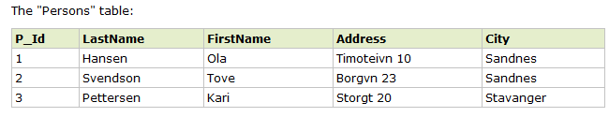
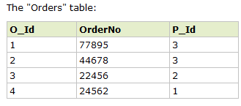
SQL Constraints

